Slide 1

Detection Of Phishing Pages Using Machine Learning
Presented By:
Varun(187R1A0504)
Vishanth(187R1A0531)
Uma Mahi(187R1A0520)
Under The Guidance Of
Dr.K.Srujan Raju

Slide 2
Abstract
There are number of users who purchase products online and make payment through e- banking. There are e- banking websites who ask user to provide sensitive data such as username, password or credit card details etc. often for malicious reasons.
This type of e-banking websites are known as phishing websites.
So here we are going to detect whether the particular webpage is phished or not using machine learning.

Slide 3
Existing Systems
The existing technique for detecting a phishing website is "Interactive teaching" where educated users and company experts will warn the users about the slight differences that can be overriden between the normal and phished website.

Slide 4
Disadvantages
Human errors may still exist due to Interactive teaching as all users can't get required training.
There may be some security issues due to the existing system.

Slide 5
Proposed system
We proposed an intelligent, flexible and effective system that is based on using classification Data mining algorithm.
We are going to use machine learning techniques to predict the future data based on the present available data.
Using the proposed technique we will analyze various blacklisted and legitimate URL's and their features to accurately detect phishing websites.

Slide 6
Advantages
The time complexity is less.
Users can securely make online payments.
Data mining algorithm used in this system provides better performance as compared to other traditional classifications algorithms.
This system can be used by many E-commerce Websites in order to have good customer relationship.

Slide 7
Machine learning techniques used
1. Decision Tree Algorithm
Decision tree begins its work by choosing best splitter from the available attributes for classification which is considered as a root of the tree. Algorithm continues to build tree until it finds the leaf node. It predicts future node based on available data.

Slide 8
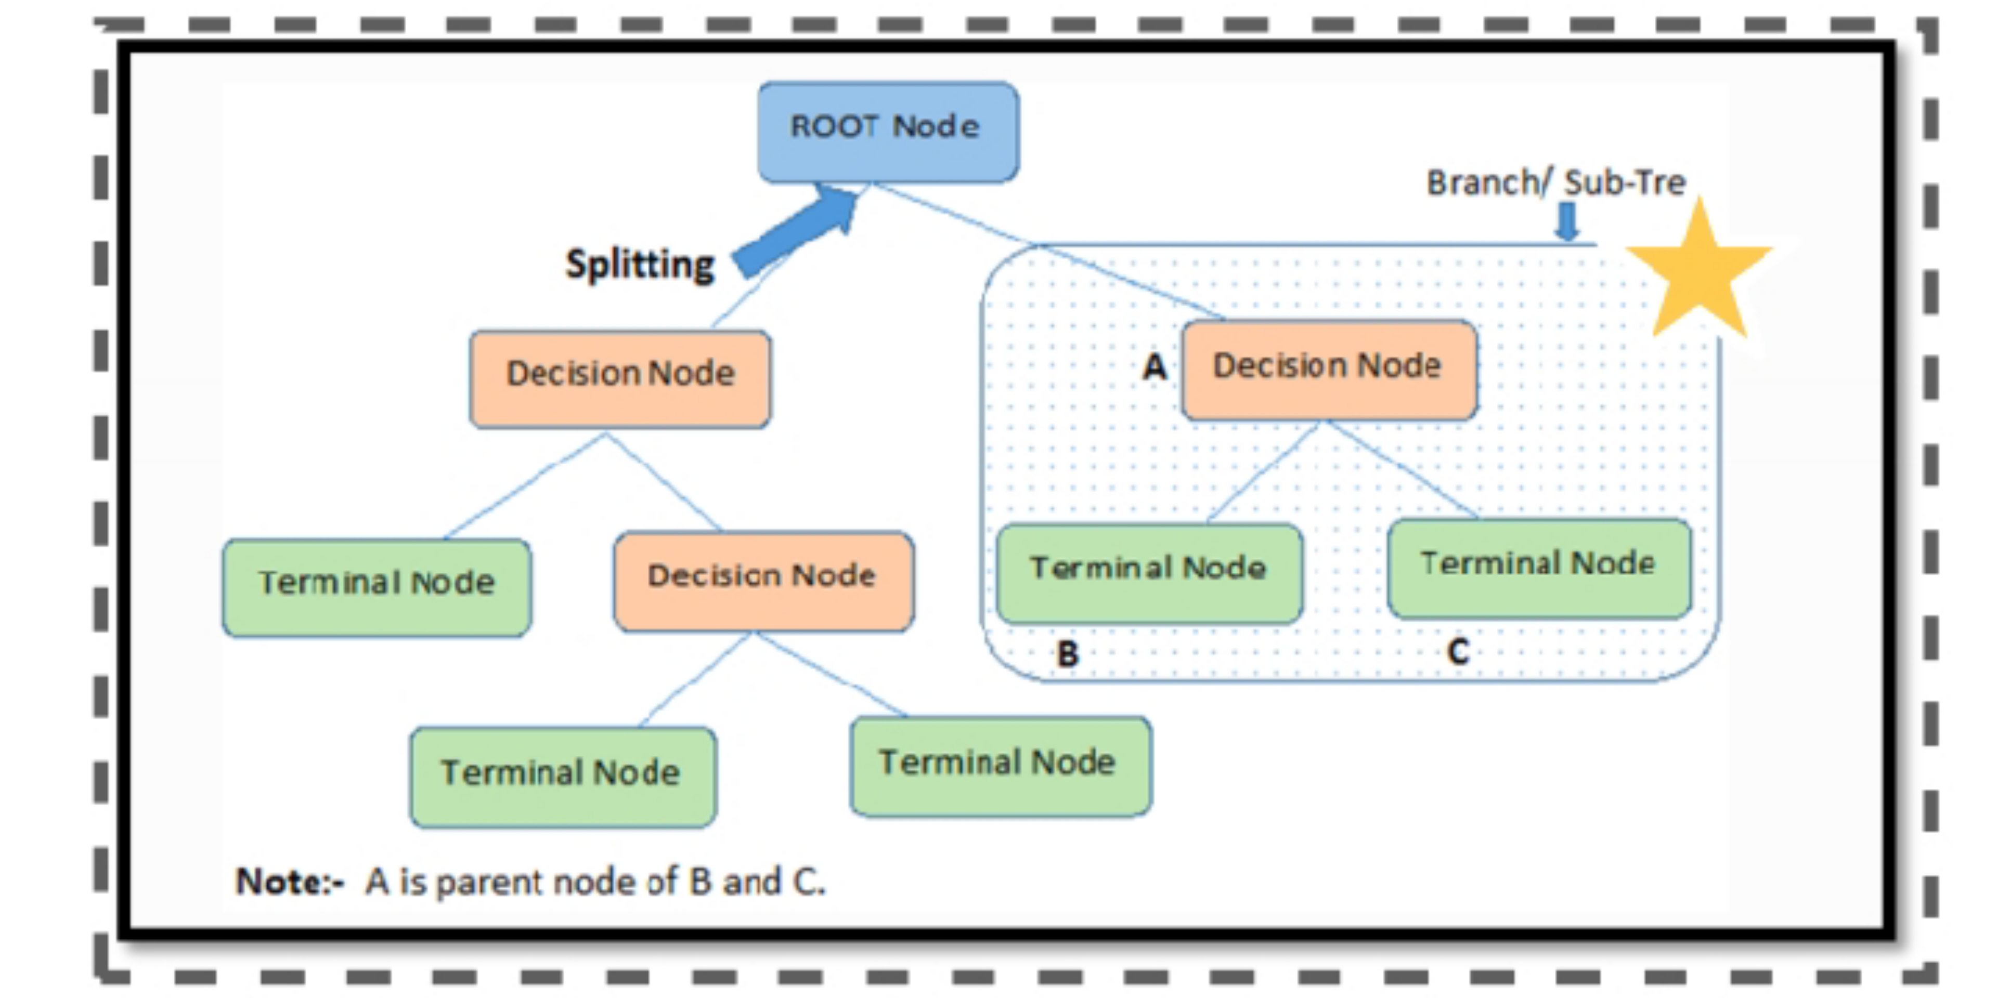

Slide 9
Machine learning techniques used
2. Random Forest Algorithm
Random forest algorithm creates the forest with number of decision trees. High number of tree gives high detection accuracy. Creation of trees are based on bootstrap method. In bootstrap method features and samples of dataset are randomly selected with replacement to construct single tree.

Slide 10
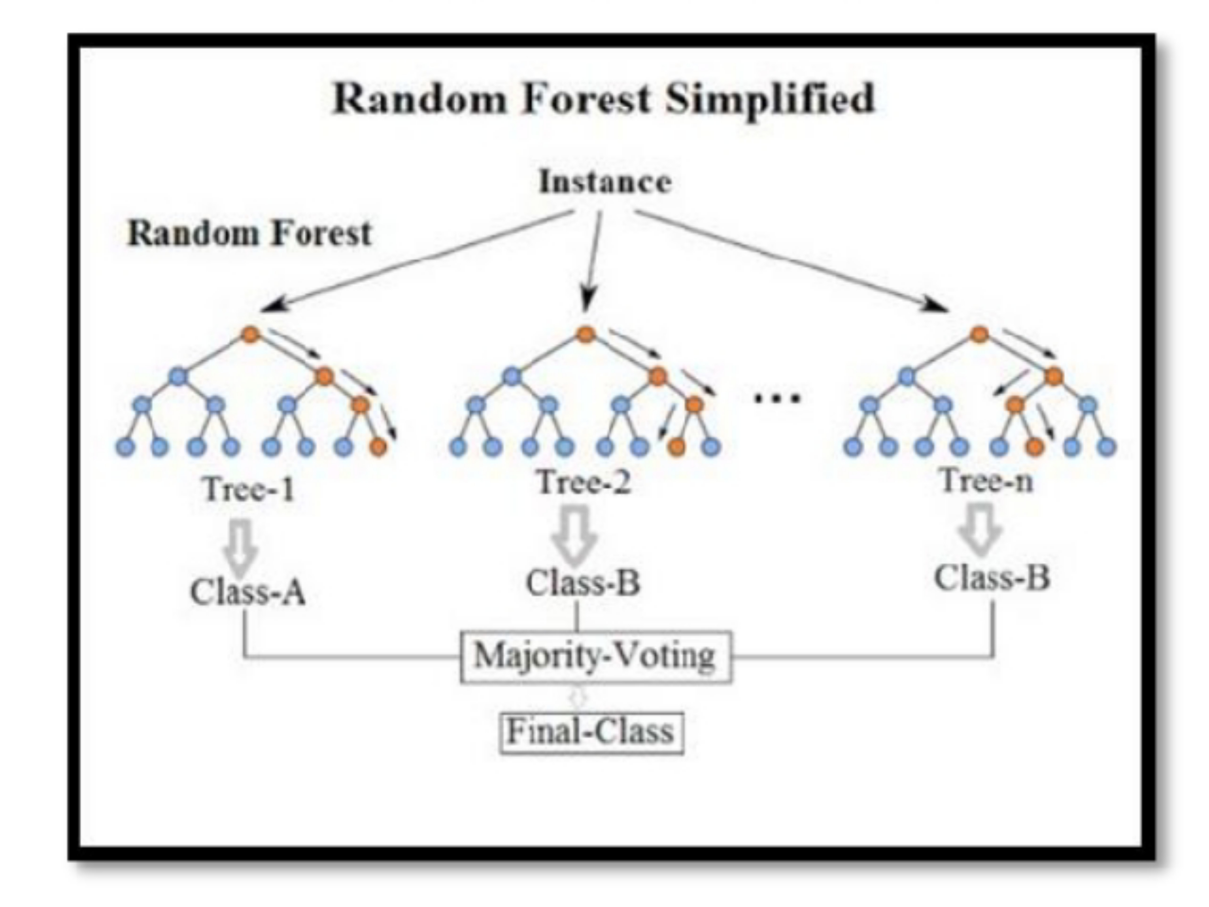

Slide 11
Hardware requirements
System. : intel i3 6006U
Hard Disk : 5 GB
Input Devices. : Keyboard, Mouse
RAM. : 4 GB

Slide 12
Software requirements
Operating System : Windows 7,8,10
Coding. : Python, CSS, HTML, Flask
Tools. : Visual studio,Google colab

Slide 13
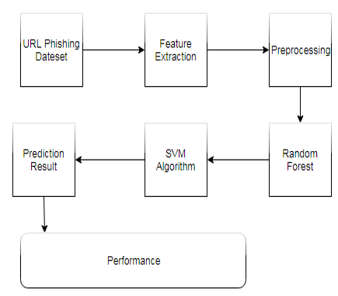
Architecture

Slide 14
Modules
Registration
Login
Add to Blacklist
Check Website
Feedback
Change Password

Slide 15
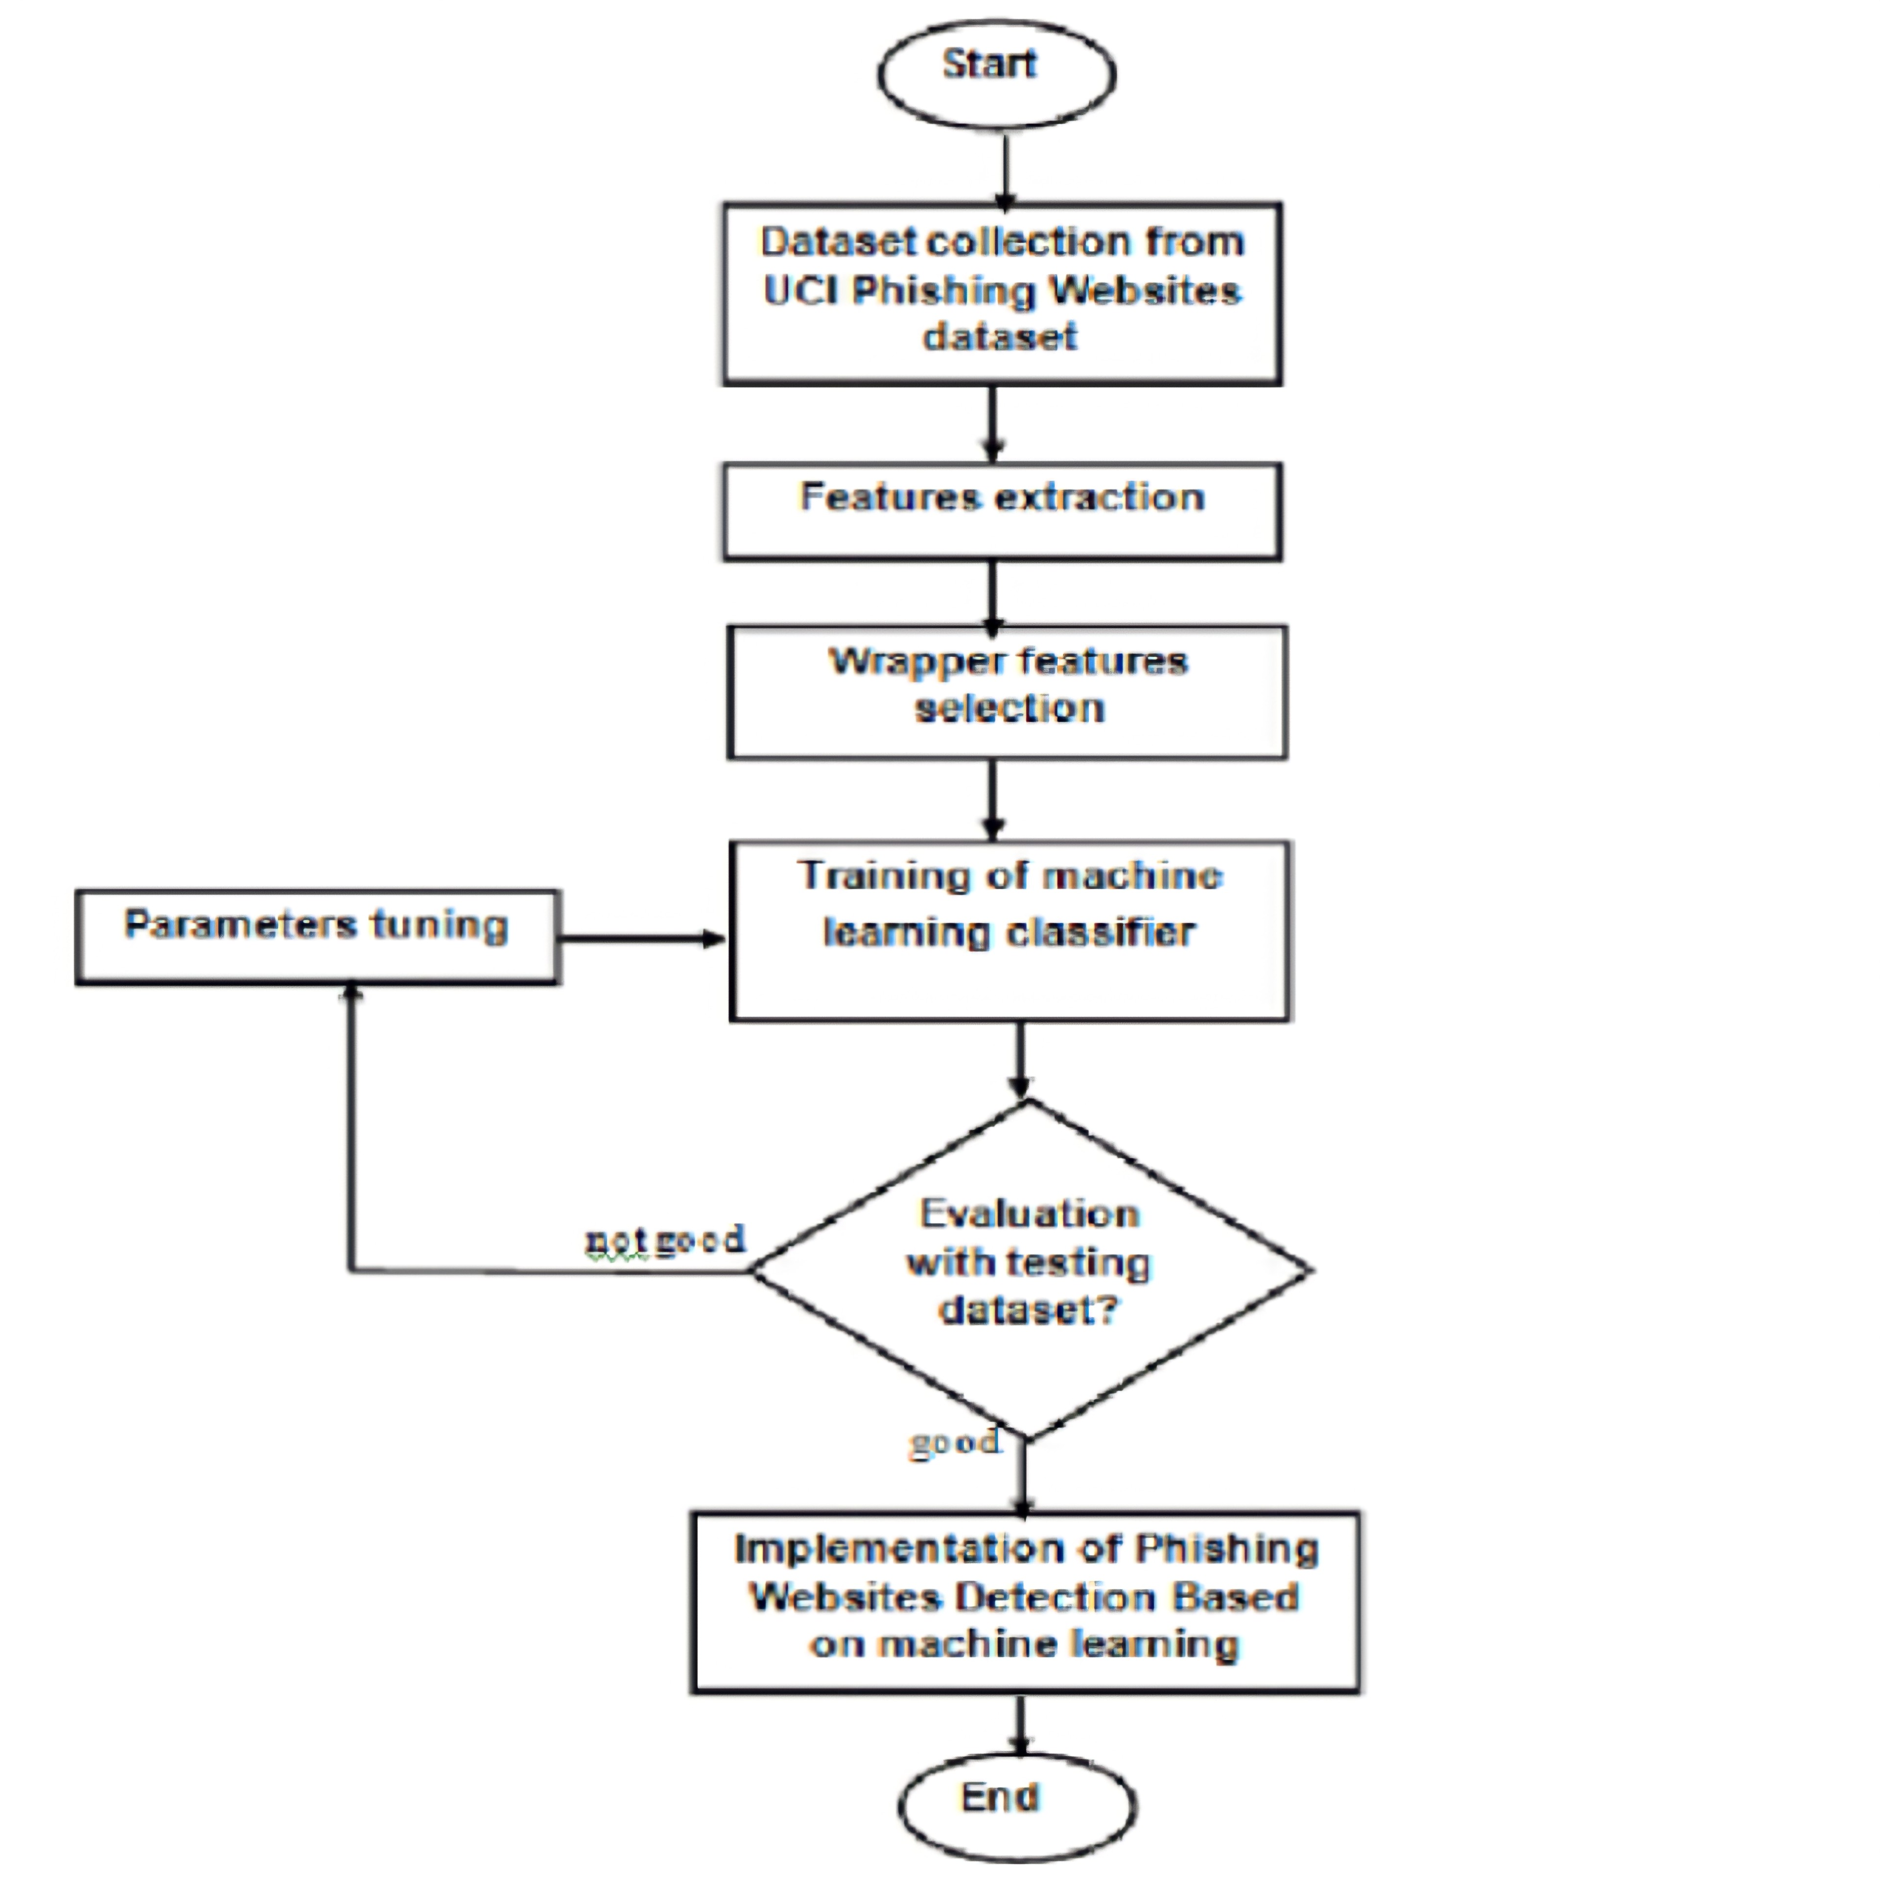
Data flow Diagram

Slide 16
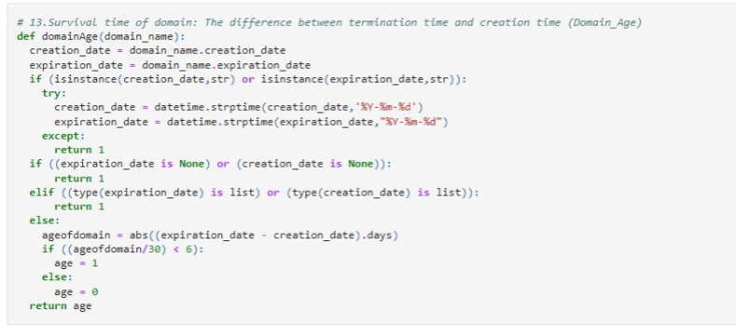
Source code

Slide 17
Applications
This system will be useful for many E-commerce enterprises.
This system will be useful for many users who purchase products online.

Slide 18
Conclusion
Every user should be trained not to blindly follow the links to websites where they have to enter their sensitive information. It is essential to check the URL before entering the website.

Slide 19
Future Enhancements
In future many features can be added to distinguish the fake web pages from the legitimate web pages.
PhishChecker application also can be upgraded into the web phone application in detecting phishing on the mobile platform.

